Slide 1
NOTAN ART
A Japanese Concept of the interplay between light and dark

Slide 2
What Will We Learn?
Review of Art terminology: positive/negative space, composition, craftsmanship, representational art, abstract art
Student Reflection and critique:
After the project, you will have the opportunity to reflect on your work in a short written statement as well as looking at the work of the class as a whole and discuss ideas and opinions.
Resources: How to Make a Notan Video:
https://www.youtube.com/watch?v=6RVf8y-e6tc

Slide 3
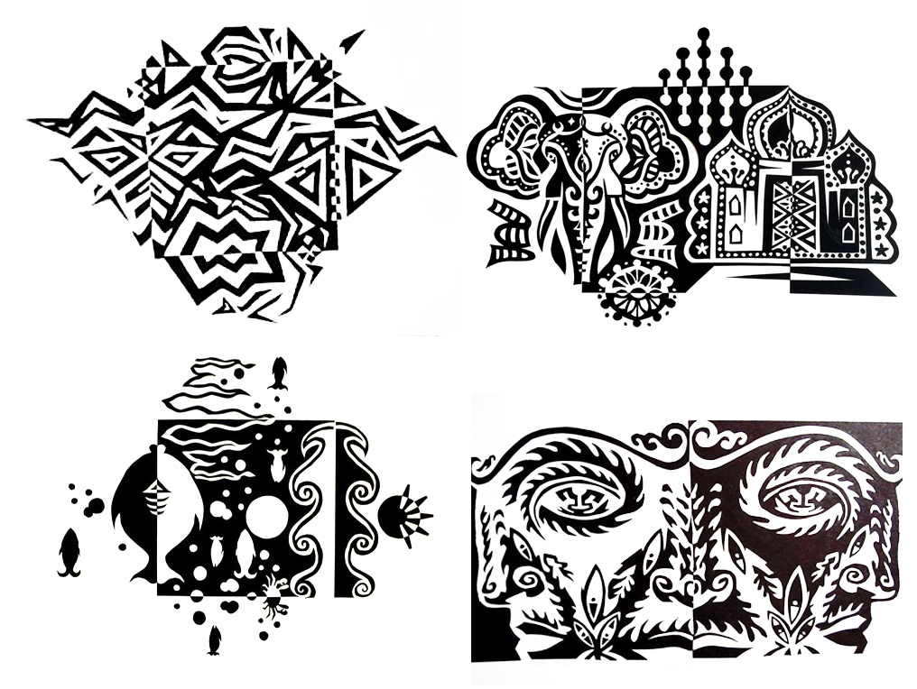
Examples of Notan
Art
These examples show both abstract design as well as representational.
Can you determine which is which?

Slide 4
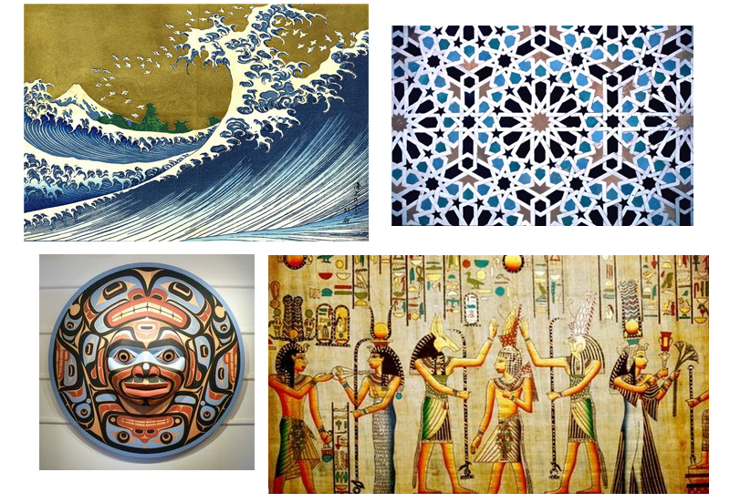
Cultural Considerations
Before you start drawing, consider a personal connection to your own cultural background or of one that you find interesting.
Research the different styles of art throughout history to develop an idea for your composition.
The examples shown are clockwise from the top left: Japanese, Islamic, Alaskan and
Egyptian

Slide 5
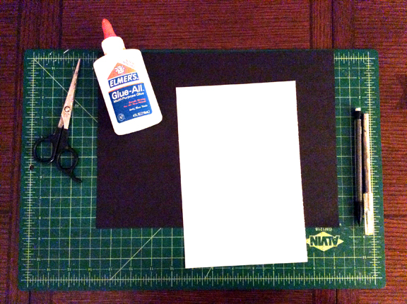
Materials you will need:
Paper, glue, scissors or X-acto knife, cutting mat and a pencil

Slide 6
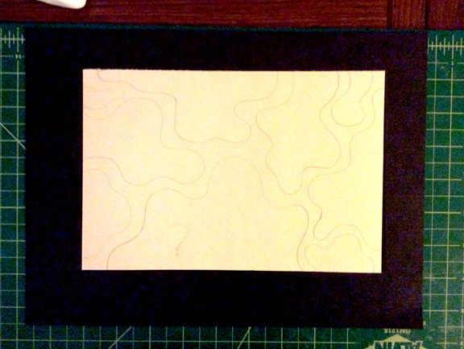
STEP 1:
Drawing your design; make sure that the shapes do not include any of the corners of the white paper. Your shapes should start and end on the same side of the paper.

Slide 7
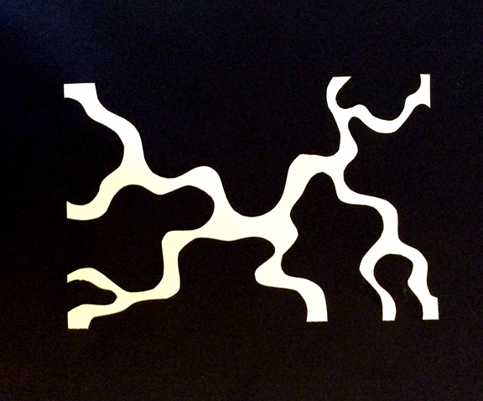
STEP 2:
Cut out your main shapes. Put the cut out pieces to the side, paper-clipped and inside an envelope.

Slide 8
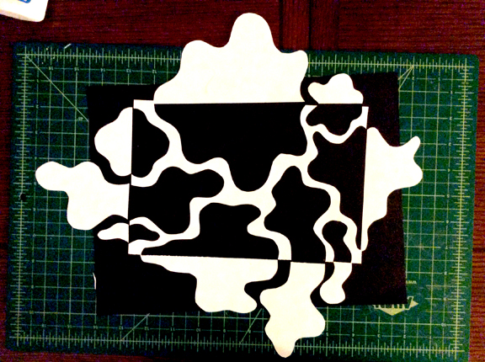
Step 3:
Check to see if your composition will fit on your black paper. It’s ok if the pieces go over the edge- you will just need to glue an additional piece of black paper to your black background.

Slide 9
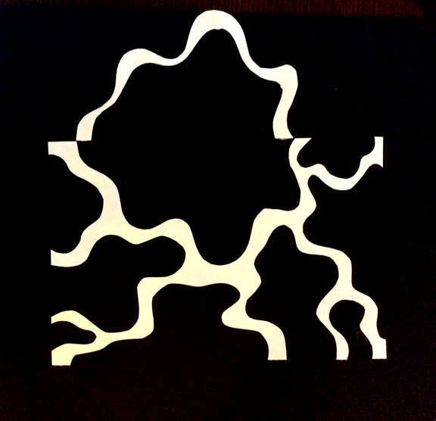
STEP4: Cutting and Gluing
Work with ONE shape at a time, cut out additional shapes, line them up on the page and glue them down. It is critical that the edges of the shapes and the empty spaces line up to create the interplay of positive and negative space.
If your shapes are large, try to cut out at least 5 interior pieces.
If your pieces are smaller, you will only have 2-3 interior shapes.
TIP: The wider the “mouth” of the shape, the easier it will be for you to cut additional shapes. Note how wide the example shape is.

Slide 10
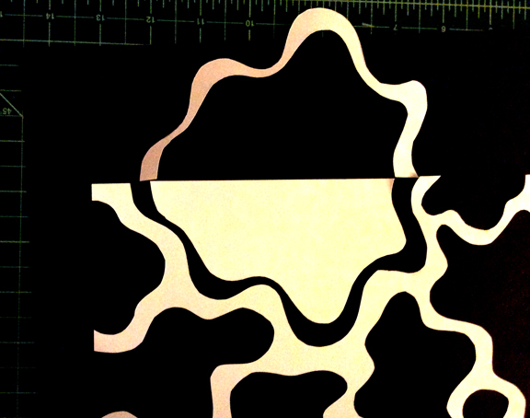
Continue cutting out shapes
Additional positive shapes will “flip” into the negative space as if they were a door on a hinge, or on a central axis.

Slide 11
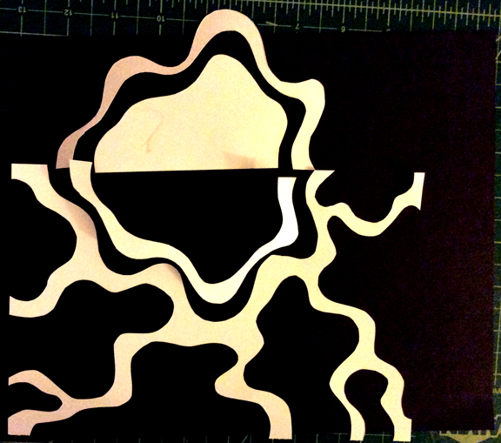
Keep going!

Slide 12
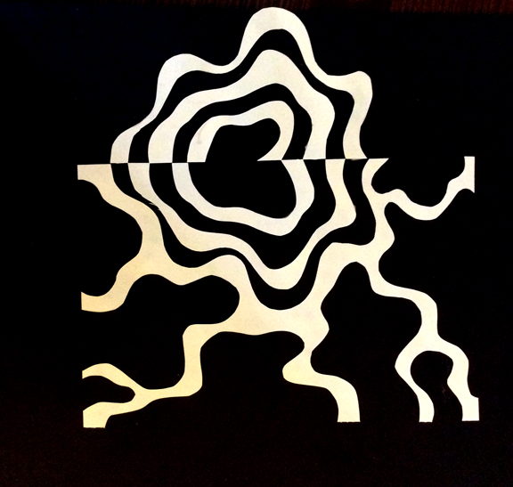
Almost there…

Slide 13
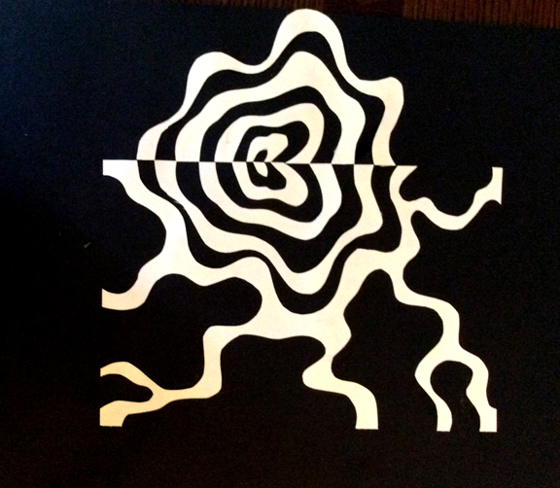
First shape complete!

Slide 14
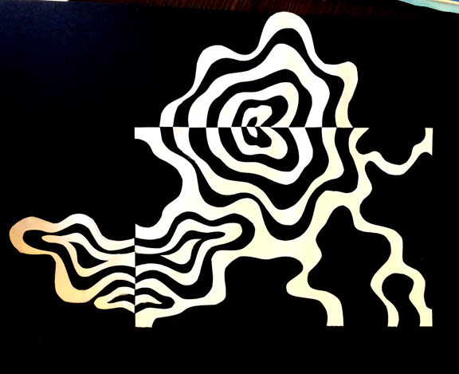
Continue with a new shape
Once your first shape has been cut out, continue with a new shape, using the same method of cutting and gluing until all the shapes have been used.

